Slide 1
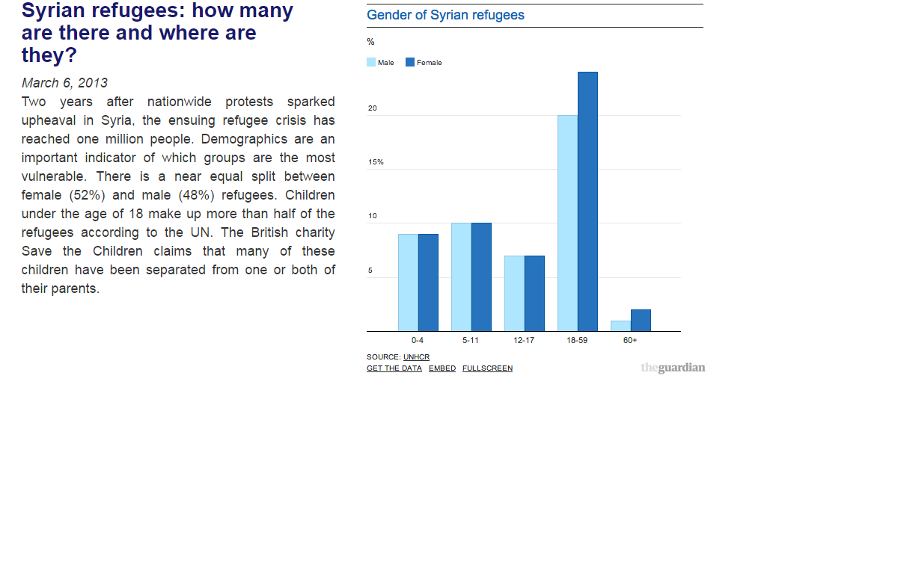
Snippet Text:
Snippet Visualization:

